Slide 1
Lesson 24 – Homework review

Slide 2
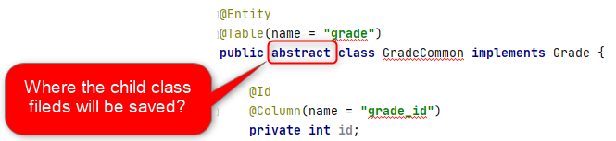
Abstract entities is something modern ☺

Slide 3
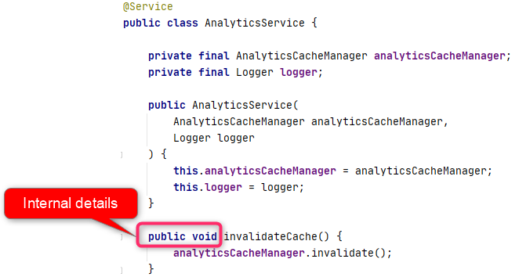
Follow encapsulation

Slide 4
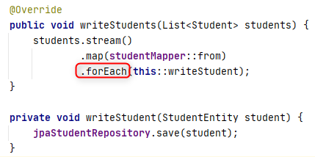
Remember about performance

Slide 5
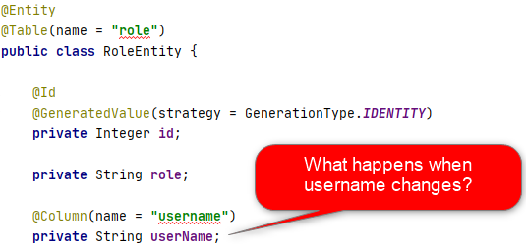
User has Role or Role has User?

Slide 6
Course works

Slide 7
Design
Single Responsibility (only a few public api’s);
Say “No Hardcode!” (use properties);
Loose coupling. Boundaries (NO entity in web-security, NO db Page on UI, NO DTO in service);
Easy to extend (Screaming Architecture);
Composition vs Inheritance (no abstract entities).

Slide 8
Database
Transactions (Apply and Apply only where required);
Optimize
filter in DB vs filter in Java;
read SQL resource once and cache;
Join vs Subquery;
Do not reinvent the wheel (Flyway, Dao, Logger).

Slide 9

Maintainability
Strict model over Json and String parsing;
Ensure all workers has work (executors);
Static initializers vs Post Construct;
Clean up unused code;
Tests. Tests. Tests.

Slide 10
Thanks!
Any Questions?
Or find us in Slack:
@Yaroslav Brahinets
@Vasya Rudas

